Slide 1
Why Functions are Called First-class citizen | First-class value | First-class object
A thing is “first-class” if it can:
Be assigned to variables
Be passed as arguments
Be returned from functions
Be stored in data structures
Python functions satisfy all.
Even More Interesting, In Python:
Functions are first-class
Classes are also first-class
Everything is an object

Slide 2
Example :
class Student:
pass
print(type(Student))
Output: <class 'type'>
So a class itself is an object created by type.
That means:
Classes are objects
Instances are objects
This is called a meta-object model.
Here pass is a do-nothing statement, It is used when a statement is syntactically required, but you don’t want to write any code yet, so we use pass.

Slide 3
What is Cpython ? (Imp)
Cpython is the implementation of Python written in C. It contains the Python compiler that converts source code into bytecode and a Python Virtual Machine that interprets the bytecode and executes the program.
CPython is not just a compiler, It is the complete implementation of Python written in C, which includes:
Python compiler(C)
Python Virtual Machine/Interpreter (PVM) (C)
Python runtime environment(C)
Python standard library(some modules in C and some in Python)
Step-by-Step Execution
When you run: python program.py
The following happens:
1. CPython uses its Python compiler
2. Source code (.py) → Bytecode (.pyc)
3. PVM (inside CPython) executes bytecode
4. Output is produced
Flow: program.py ↓ Python Compiler (inside CPython) ↓ Bytecode (.pyc) ↓ Python Virtual Machine (inside CPython) ↓ Execution

Slide 4
Internal working of Python
Python doesn't convert its code into machine code, something that hardware can understand.
It converts it into something called byte code(.pyc ).
Now PVM takes this bytecode.
PVM is the runtime engine of Python and it itself acts as the interpreter that executes bytecode.

Slide 5
How Python Internally Works Explanation?
Code Editor: Code Editor is the first stage of programs where we write our source code. This is human-readable code written according to Python's syntax rules. It is where the execution of the program starts first.
Source code: The code written by a programmer in the code editor is then saved as a .py file in a system. This file of Python is written in human-readable language that contains the instructions for the computer.
Compilation Stage: The compilation stage of Python is different from any other programming language. Rather than compiling a source code directly into machine code, python compiles a source code into a byte code. In the compilation stage python compiler also checks for syntax errors. After checking all the syntax errors, if no such error is found then it generates a .pyc file that contains bytecode.

Slide 6
Python Virtual Machine(PVM): The bytecode then goes into the main part of the conversion is the Python Virtual Machine(PVM). The PVM is the main runtime engine of Python. It is an interpreter that reads and executes the bytecode file, line by line. Here In the Python Virtual Machine translate the byte code into machine code which is the binary language consisting of 0s and 1s. The machine code is highly optimized for the machine it is running on. This binary language is only understandable by the CPU of a system.
Running Program: At last, the CPU executes the given machine code and the main outcome of the program comes as performing task.

Slide 7
What is __pycache__ in Python? (Imp)
__pycache__ is a folder where Python stores compiled bytecode files (.pyc) generated from .py source files.
So Python does not need to compile the file again next time, which makes execution faster.
Example Suppose we have a file: hello.py
print("Hello Python")
When you run: python hello.py
Python automatically creates: __pycache__/
Inside it you will see something like:
hello.cpython-311.pyc
Part | Meaning
hello | Original Python file name
cpython | Python implementation used
311 | Python version 3.11
.pyc | Compiled bytecode file

Slide 8
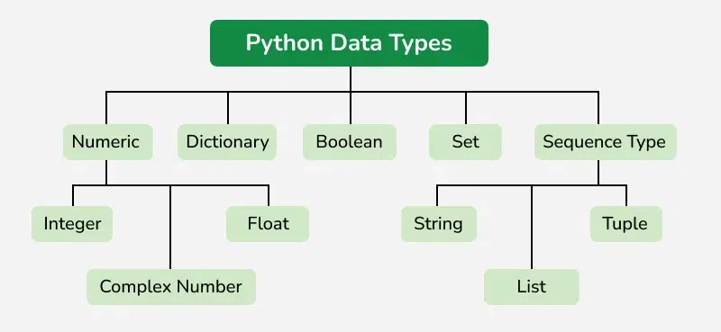

Slide 9
The following are standard or built-in data types in Python:
Numeric: int, float, complex
Sequence Type: string, list, tuple
Mapping Type: dict
Boolean: bool
Set Type: set, frozenset
Binary Types: bytes, bytearray, memoryview

Slide 10
Numeric Data Types
Python numbers represent data that has a numeric value. A numeric value can be an integer, a floating number or even a complex number. These values are defined as int, float and complex classes.
Integers: value is represented by int class. It contains positive or negative whole numbers (without fractions or decimals). There is no limit to how long an integer value can be.
Float: value is represented by float class. It is a real number with a floating-point representation. It is specified by a decimal point. Optionally, character e or E followed by a positive or negative integer may be appended to specify scientific notation.
Complex Numbers: It is represented by a complex class. It is specified as (real part) + (imaginary part)j. For example - 2+3j

Slide 11
Sequence Data Types
A sequence is an ordered collection of items, which can be of similar or different data types. Sequences allow storing of multiple values in an organized and efficient fashion. There are several sequence data types of Python:
String Data Type
Python Strings are arrays of bytes representing Unicode characters. In Python, there is no character data type, a character is a string of length one. It is represented by str class.
Strings in Python can be created using single quotes, double quotes or even triple quotes. We can access individual characters of a String using index.

Slide 12
s = 'Welcome to the Geeks World'
print(s)
​
# check data type
print(type(s))
​
# access string with index
print(s[1])
print(s[2])
print(s[-1])
Output
Welcome to the Geeks World
<class 'str'>
e
l
d

Slide 13
Creating a List in Python
Lists in Python can be created by just placing sequence inside the square brackets[].
List is Mutable which means we can modify list after creation.
# Empty list
a = []
​
# list with int values
a = [1, 2, 3]
print(a)
Tuple Data Type
Tuple is an ordered collection of Python objects. The only difference between a tuple and a list is that tuples are immutable. Tuples cannot be modified after it is created.
# initiate empty tuple
tup1 = ()
​
tup2 = ('Geeks', 'For')
print("\nTuple with the use of String: ", tup2)

Slide 14
Set Data Type
In Python Data Types, Set is an unordered collection of data types that is iterable, mutable, and has no duplicate elements.
# initializing empty set
s1 = set()
​
s1 = set("GeeksForGeeks")
print("Set with the use of String: ", s1)
​
s2 = set(["Geeks", "For", "Geeks"])
print("Set with the use of List: ", s2)
Output
Set with the use of String: {'s', 'o', 'F', 'G', 'e', 'k', 'r'}
Set with the use of List: {'Geeks', 'For'}

Slide 15
set1 = set(["Geeks", "For", "Geeks"]) #Duplicates are removed automatically
print(set1)
​
# loop through set
for i in set1:
print(i, end=" ") #prints elements one by one
# check if item exist in set
print("Geeks" in set1)
Output
{'For', 'Geeks’}
True

Slide 16
Dictionary Data Type
A dictionary in Python is a collection of data values, used to store data values like a map, unlike other Python Data Types, a Dictionary holds a key: value pair. Key-value is provided in dictionary to make it more optimized. Each key-value pair in a Dictionary is separated by a colon : , whereas each key is separated by a ‘comma’.
Create a Dictionary in Python
Values in a dictionary can be of any datatype and can be duplicated, whereas keys can’t be repeated and must be immutable. The dictionary can also be created by the built-in function dict().
Note - Dictionary keys are case sensitive, the same name but different cases of Key will be treated distinctly.

Slide 17
# initialize empty dictionary
d = {}
​
d = {1: 'Geeks', 2: 'For', 3: 'Geeks'}
print(d)
​
# creating dictionary using dict() constructor
d1 = dict({1: 'Geeks', 2: 'For', 3: 'Geeks'})
print(d1)
Output
{1: 'Geeks', 2: 'For', 3: 'Geeks'}
{1: 'Geeks', 2: 'For', 3: 'Geeks'}

Slide 18
Key points:
A list is a built-in data structure in Python.
Features:
Can store different data types (int, string, float, objects)
Dynamic size (can grow/shrink easily)
Easy to use (no import required)
Example:
my_list = [10, "Gaurav", 3.14, True]
print(my_list)
An array is used to store same type of elements only.
Python supports arrays via: array module Or commonly via NumPy arrays
Features:
Stores homogeneous data (same type)
More memory efficient
Faster for numerical operations

Slide 19
Python Interactive Mode vs Script Mode
Python programs can be executed in two ways:
Interactive Mode
Script Mode
Python Interactive Mode
Interactive mode is where we write and execute Python statements one by one directly in the interpreter.
The interpreter immediately executes and shows the result.
How to Start Interactive Mode
Open terminal/command prompt and type:
python
You will see:
>>>
This is the Python prompt.
Example >>> 5 + 3 8 >>> print("Hello") Hello Here the code runs immediately.
Uses Testing small code Learning Python Debugging simple expressions

Slide 20
Python Script Mode
In script mode, we write Python code in a file with extension: .py
Then run the program using the Python interpreter.
Example
Create file: hello.py
Code:
print("Hello Python")
print(10 + 20)
Run program:
python hello.py
Output:
Hello Python
30
Interactive Mode >>> x = 10 >>> y = 20 >>> x + y 30
Script Mode x = 10 y = 20 print(x + y) Run: python program.py Output: 30
Interactive mode executes Python commands one by one directly in the interpreter, while script mode runs Python programs saved in .py files.

